Slide 1
Defensive Security Project
by: Adam, Ben, Rose & Ryan

Slide 2
Table of Contents
This document contains the following resources:
Monitoring Environment
Attack Analysis
Project Summary & Future Mitigations

Slide 3

Monitoring Environment
‹#›

Slide 4
Scenario
Working as a Security Operations Analyst for the company Virtual Space Industries (VSI), who design virtual reality programs for businesses.
A competitor, JobeCorp has launched cyberattacks and took down several VSI systems
As SOC analysts, we are tasked with using Splunk to monitor potential attacks on VSI’s systems and applications.
The products we have been given to monitor include:
- An Apache web server, which hosts the administrative webpage
- A Windows operating system, which runs many of VSI’s back-end operations

Slide 5
[Splunk Add-on for Unix and Linux]
‹#›

Slide 6
Splunk Add-on for Unix and Linux
The Splunk Add-on for Unix and Linux works with the Splunk App for Unix and Linux to provide rapid insights and operational visibility into large-scale Unix and Linux environments. With its new pre-packaged alerting capability, flexible service-based hosts grouping, and easy management of many data sources, it arms administrators with a powerful ability to quickly identify performance and capacity bottlenecks and outliers in Unix and Linux environments

Slide 7
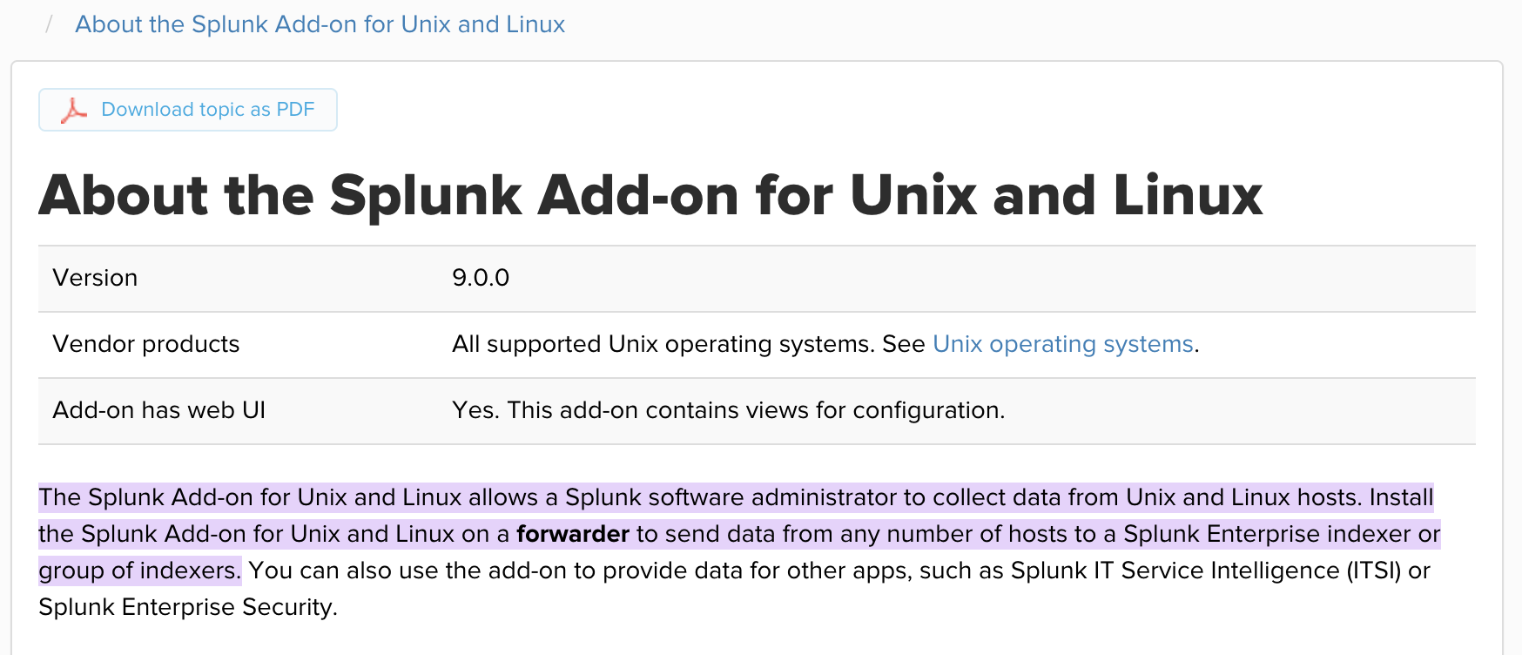
Splunk Add-on for Unix and Linux

Slide 8
Splunk Add-on for Unix and Linux
A user can use the Splunk Add-On for Unix and Linux for 2 reasons.
Collect performance metrics from Unix hosts or Linux hosts without CollectD*
Collect security events from Unix or Linux hosts
*The collectd agent is an open source daemon that collects system and application performance metrics.
Benefits
The Splunk App for Unix and Linux collects around 200MB of data per host per day. The app can collect slightly more or less based on individual host activity.
Collects data using file inputs and scripted inputs
Combine with other apps such as such as Splunk IT Service Intelligence or Splunk Enterprise Security.
Support for a new linux OS, SUSE Linux Enterprise Server version 15SP5.

Slide 9
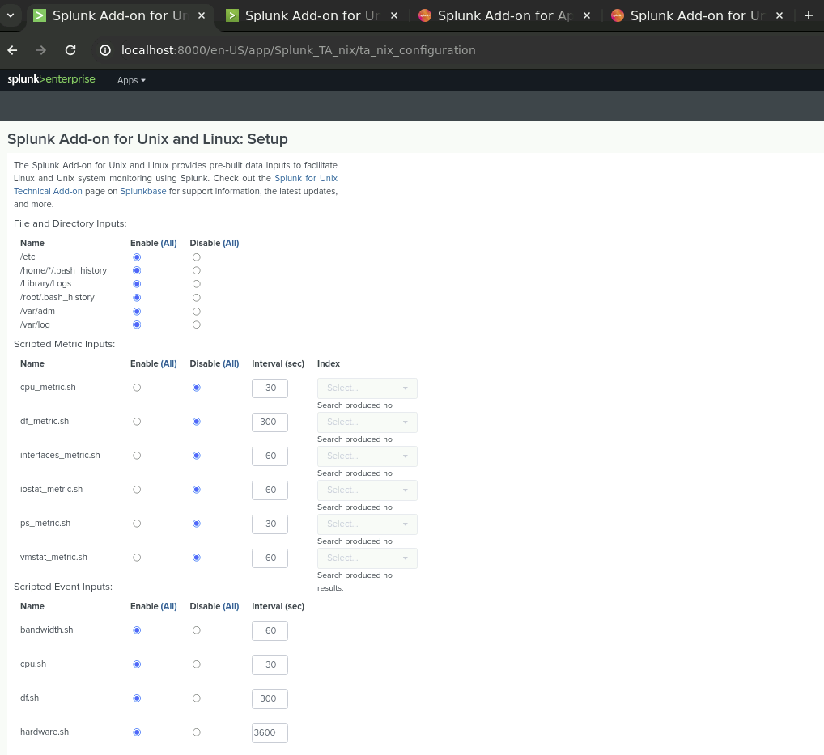
Splunk Add-on for Unix and Linux

Slide 10
Logs Analyzed
Windows Logs
Apache Logs
1
2
This server contains intellectual property of VSI’s next-generation virtual-reality programs.
This server is used for VSI’s main public-facing website, vsi-company.com.

Slide 11
Windows Logs
‹#›

Slide 12
Reports—Windows
Designed the following reports:
Report Name | Report Description
VSI_WindowsActivity_signatures | This will allow VSI to view reports that show the ID number associated with specific signature for Windows Activity
VSI_SeverityLevels_Count&Percentage | This will allow VSI to quickly understand the severity levels of the Windows logs being viewed
VSI_WindowsActivity_Activity | This will show VSI if there is a suspicious level of failed activities on their server

Slide 13
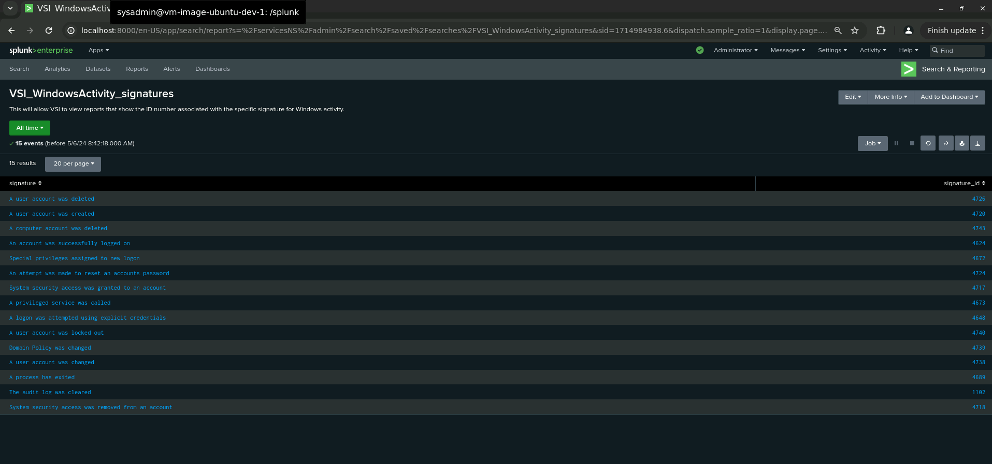
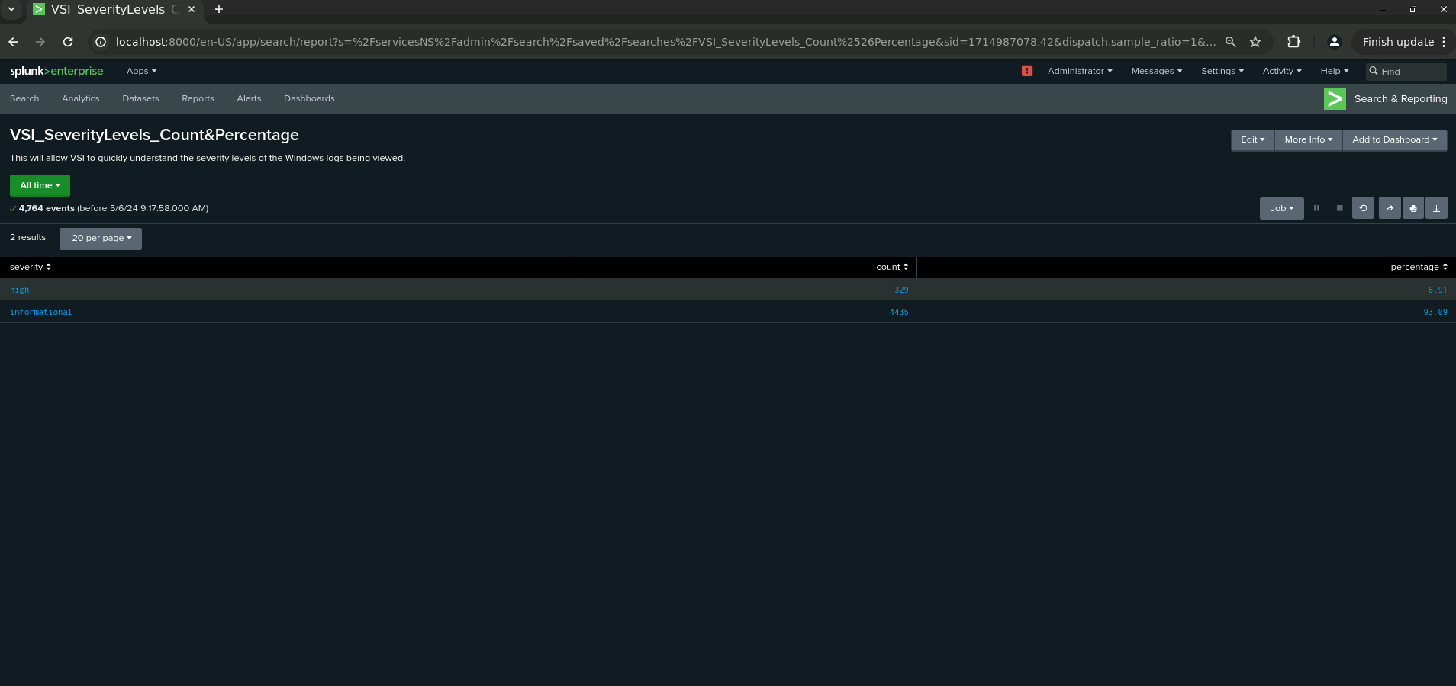
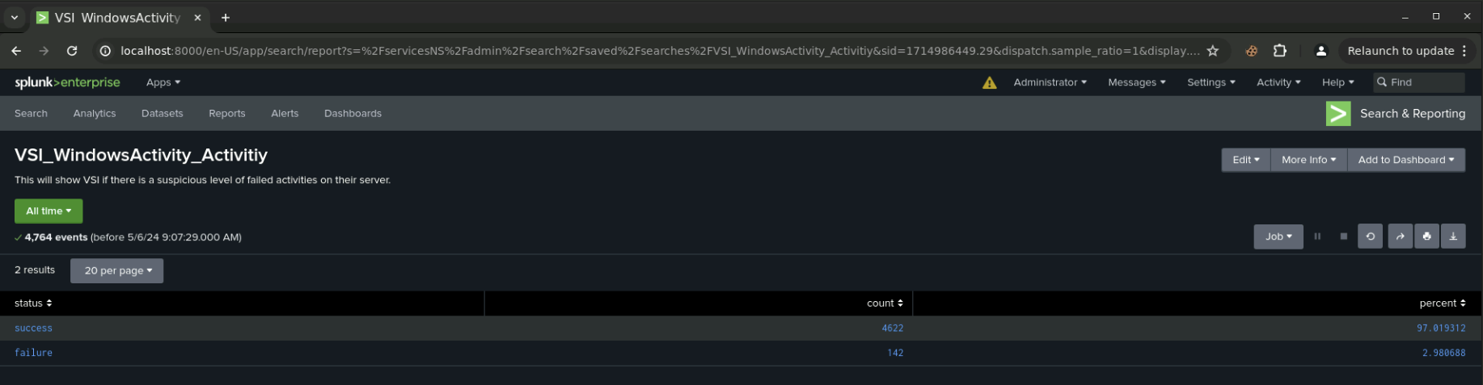
Images of Reports—Windows
Report Image
Report Image

Slide 14
Alerts—Windows
Designed the following alerts:
Alert Name | Alert Description | Alert Baseline | Alert Threshold
VSI_WindowsActivity_Failure_Alert | Failure alert with threshold of 15 per hour | 5-10 | >15
JUSTIFICATION: The average amount of failed Windows activity was between 5-10. Failures exceeding 15 would definitely raise suspicious activity

Slide 15
Alerts—Windows
Designed the following alerts:
Alert Name | Alert Description | Alert Baseline | Alert Threshold
VSI_Successful_Logons_Alert | Alert for successful logons with threshold of 30 | 13 | >30
JUSTIFICATION: The hourly count of successful logons average was around 13. Logons exceeding 30 would raise suspicious behaviour.

Slide 16
Alerts—Windows
Designed the following alerts:
Alert Name | Alert Description | Alert Baseline | Alert Threshold
VSI_WindowsActivity_Deleted_Accounts_Alert | Failure alert with threshold of 25 per hour an email will be sent. | 15 | >25
JUSTIFICATION: A baseline of 15 seemed normal within the hour. Anything exceeding 25 would raise suspicion levels and indicate a problem

Slide 17
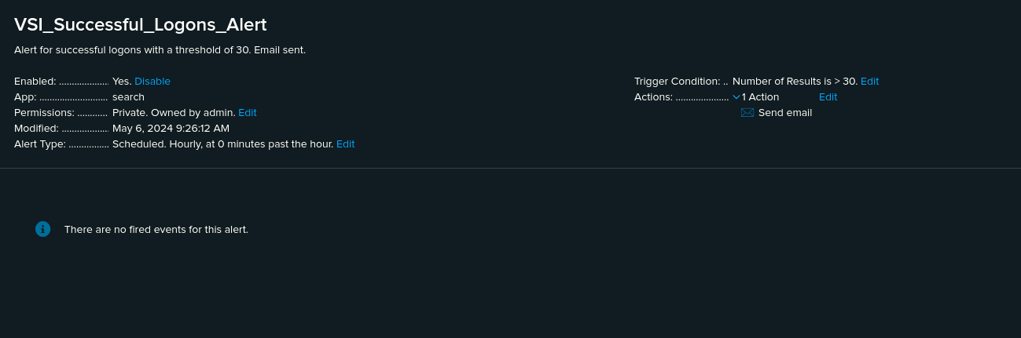
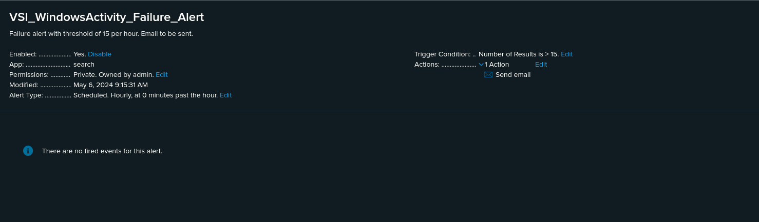
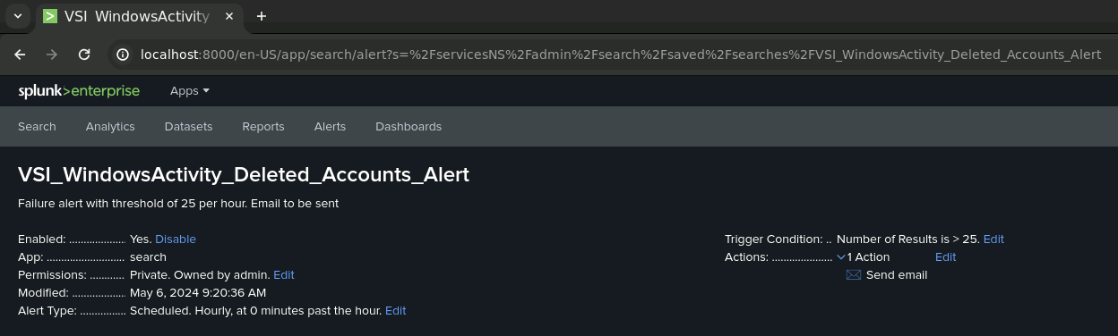
Image of Alerts- Windows

Slide 18
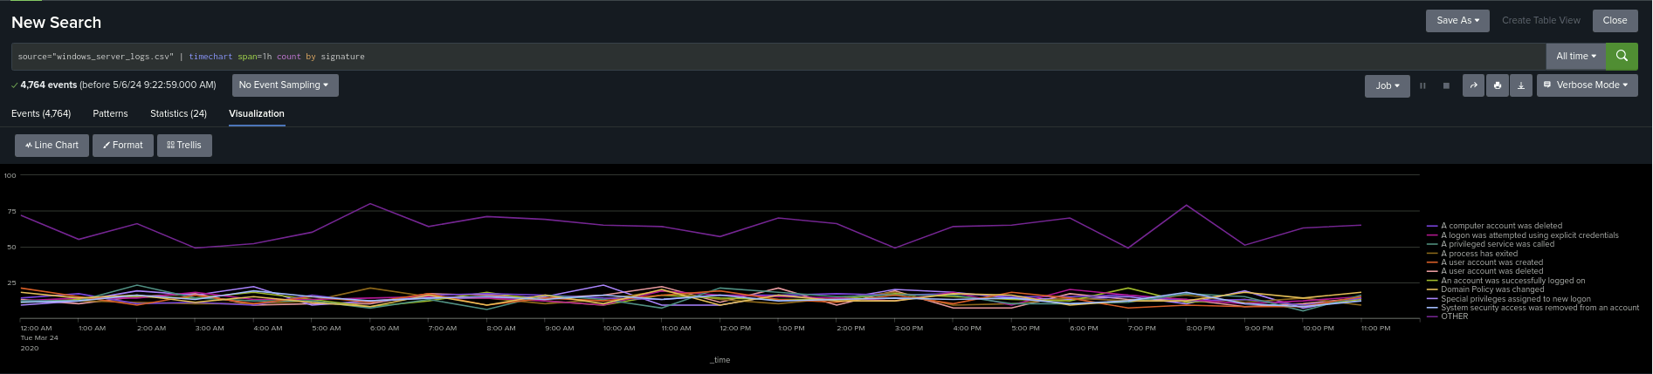
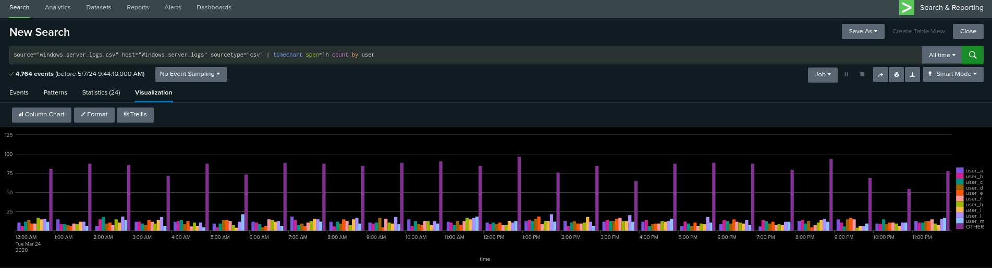
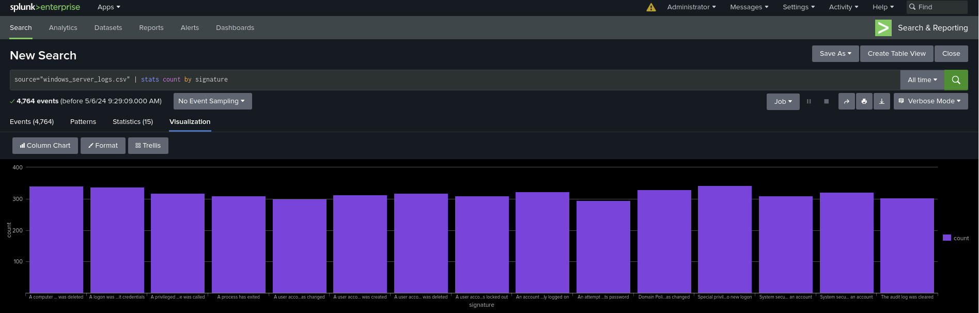
Dashboards—Windows

Slide 19
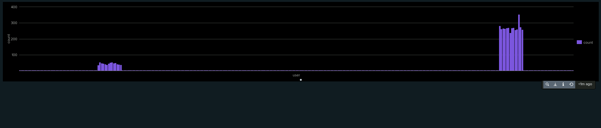
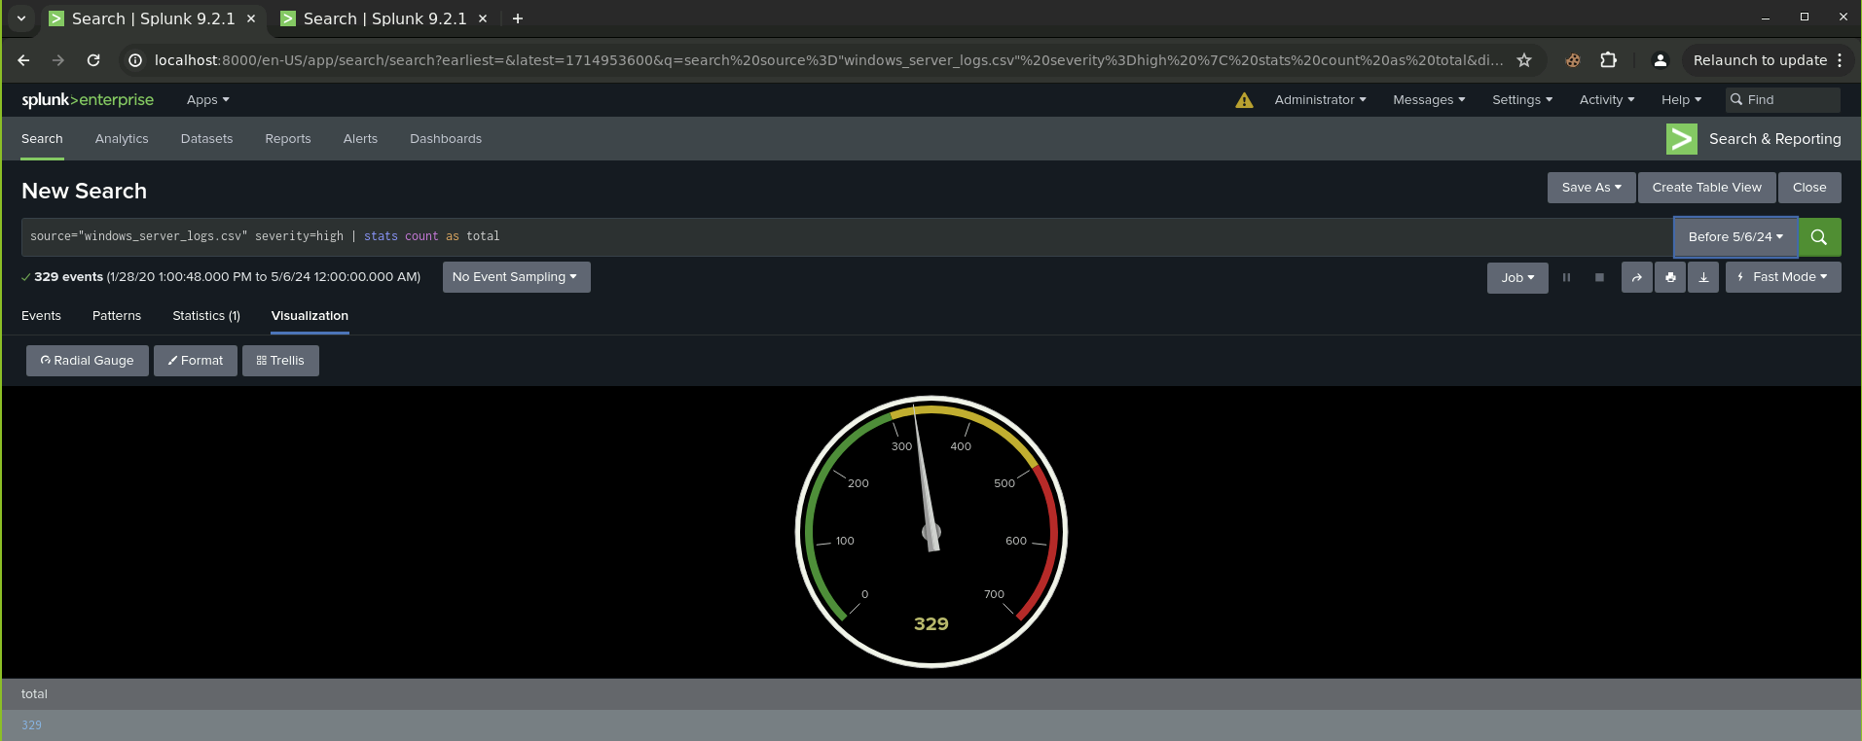
Dashboards—Windows

Slide 20
Apache Logs
‹#›

Slide 21
Reports—Apache
Designed the following reports:
Report Name | Report Description
Apache_Logs_HTTP_Methods | HTTP types being requested against VSI’s web server
VMI_Apache_referer_domain_report | Apache report that show the top 10 domain’s that refer to VSI’s website
Apache_Logs_Response_Codes | Count of each HTTP response code

Slide 22
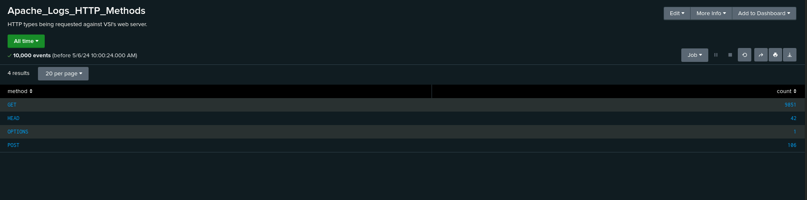
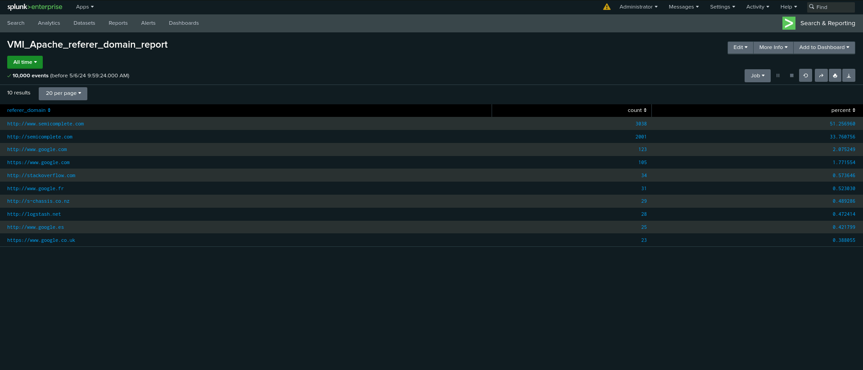
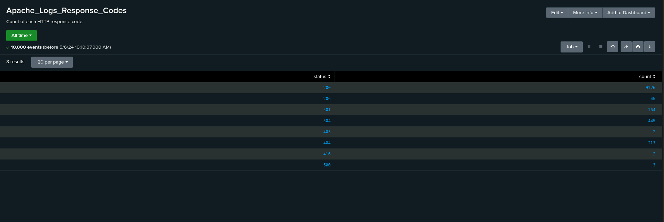
Images of Reports—Apache

Slide 23
Alerts—Apache
Designed the following alerts:
Alert Name | Alert Description | Alert Baseline | Alert Threshold
VMI_Apache_hourlyactivity_non_US_country | An email will be sent if the hourly activity from any country besides the US exceeds the threshold | 175 | >250
JUSTIFICATION: Compared the hourly activity of VSI from any country besides the US and on average 175 events seemed normal and anything exceeding 250 would indicate their were issues.

Slide 24
Alerts—Apache
Designed the following alerts:
Alert Name | Alert Description | Alert Baseline | Alert Threshold
Apache_logs_HTTP_POST_Alert | Alert for HTTP POST requests with a threshold of 10 that runs every hour. Email Sent | 2.5 | >10
JUSTIFICATION: Calculating the average of the alert baseline was 2.5. A threshold of 10 seemed like a number small enough that would catch malicious activity for an hourly count.

Slide 25
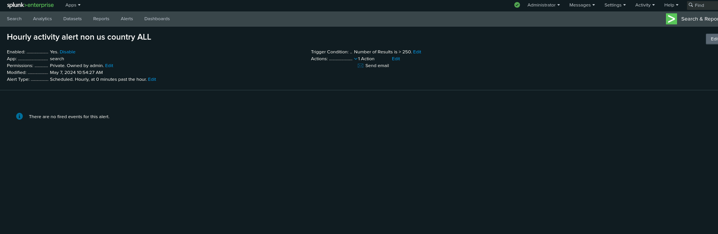
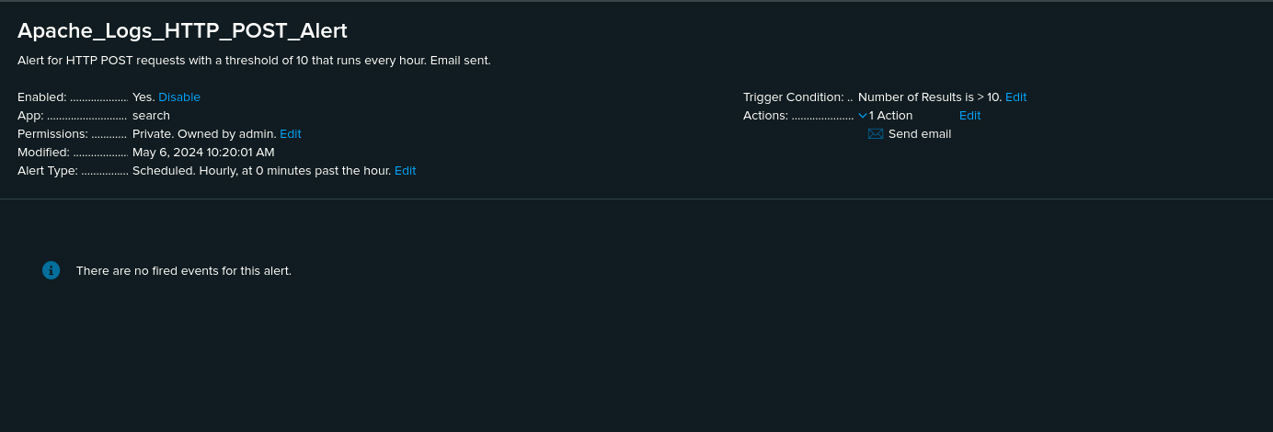
Images of Alerts—Apache

Slide 26
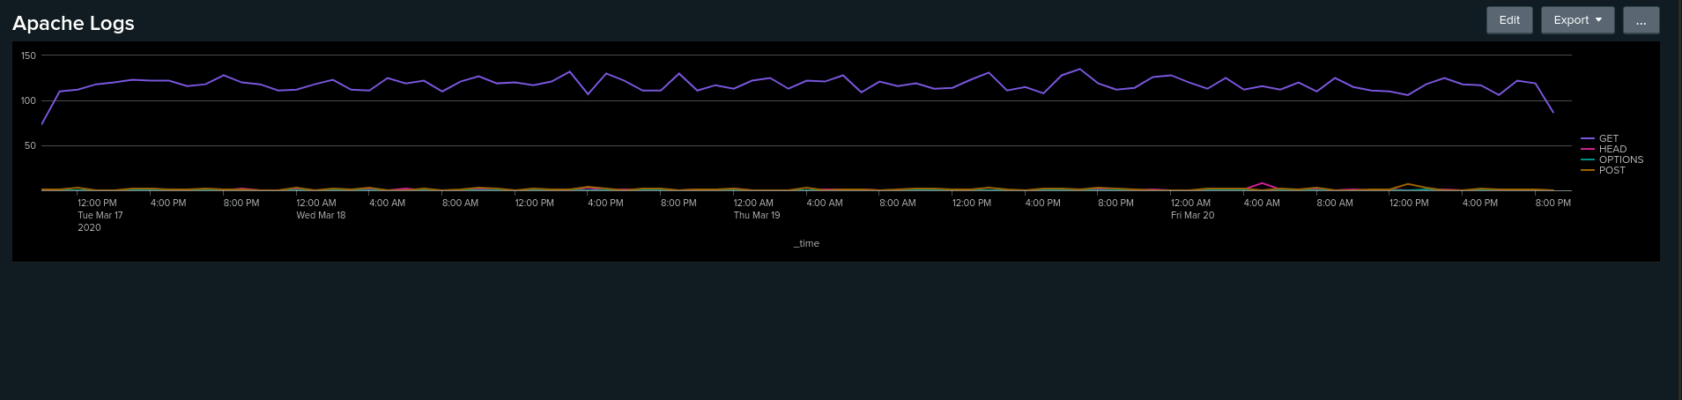
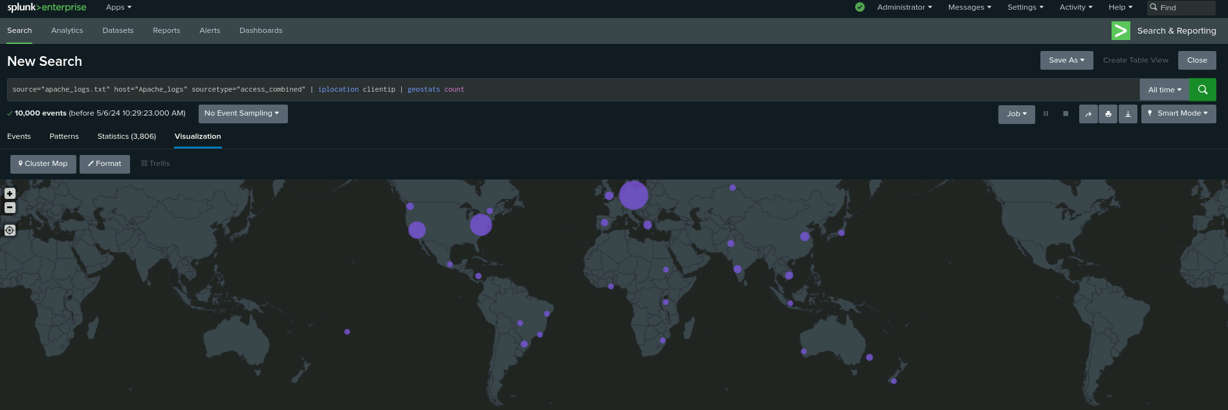
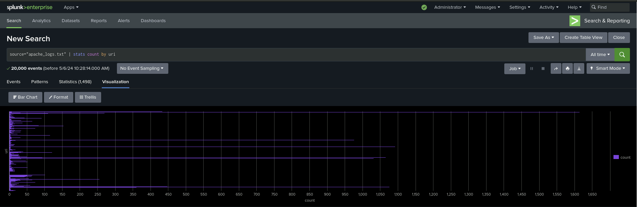
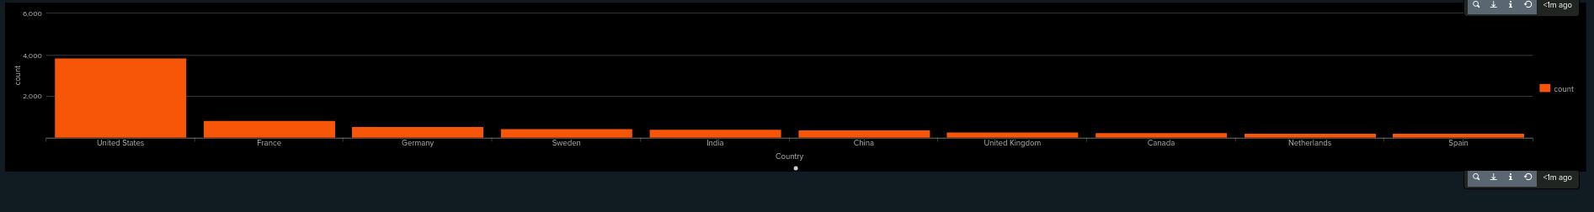
Dashboards—Apache
Place image here
Place image here
Place image here

Slide 27
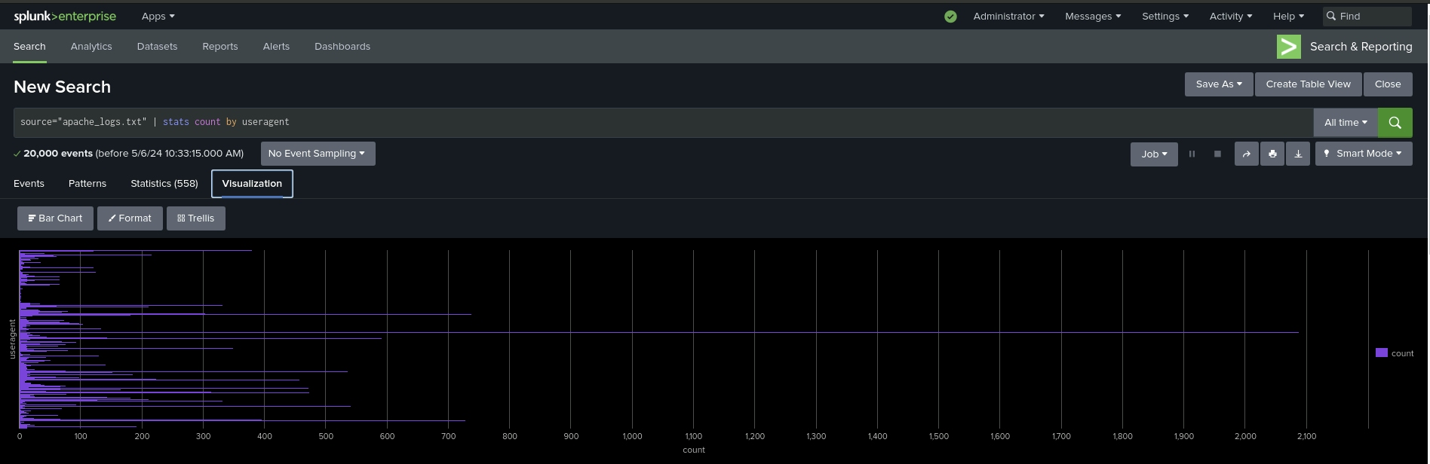
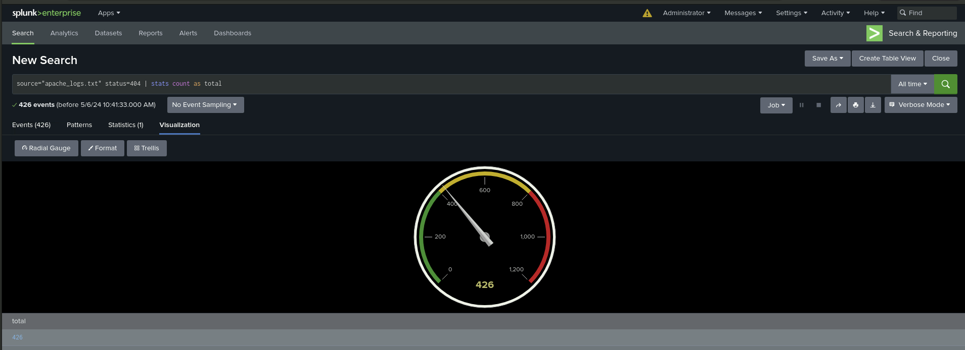
Dashboards—Apache

Slide 28
Attack Analysis
‹#›

Slide 29
Attack Summary—Windows
Summarize your findings from your reports when analyzing the attack logs.
In comparison to the previous logs we found that there were now 1111 high severity alerts, as opposed to there previously being only 329 with the previous logs. This meant that the percentage of high severity alerts rose from 6.91% to 20.22%.
For the failed activities, it was noted that there were more successes than failures. The failed Windows activity had a 1.56% and compared to the previous logs, there was a suspicious volume of failed activity.

Slide 30
Attack Summary—Windows
Summarize your findings from your alerts when analyzing the attack logs. Were the thresholds correct?
Failed Windows Activity - We detected suspicious activity at 8AM 25/03/2020 with the Failed Windows Activity attack logs. During our findings we found that our threshold could be increased slightly to >20 due to potential alerting for genuine activity although our alert still picked up on the suspicious activity.
Successful Logons - We detected suspicious activity at 1AM to 3AM and also 8AM - 11AM 25/03/2020 with the Successful Logins attack logs. During our findings we found that our thresholds were correct and there would be no changes made as we had it at >30 whereas there was no genuine activity that exceeded the threshold.
Deleted Accounts - We found there was no suspicious activity within the Deleted Accounts attack logs.

Slide 31
Attack Summary—Windows
Summarize your findings from your dashboards when analyzing the attack logs.
From 08:00 to 09:00 on March 25 2020 we have found that there was a significant spike in attempts to reset a password. (1258 attempts)
User_K had the highest amount of activity during the period that passwords were trying to be reset.
Prior to this at 01:00 there was another spike in the signature of user accounts being locked out. (896 attempts)
User_A had the highest amount of activity during the period in which accounts were being locked out.

Slide 32
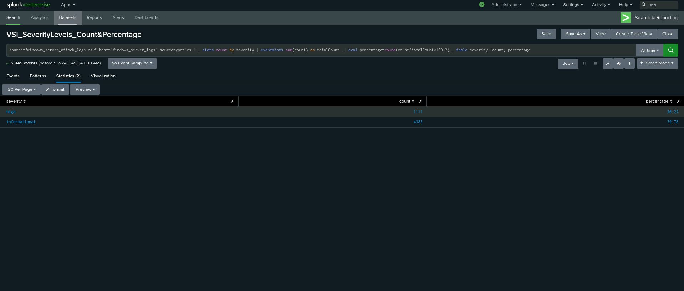
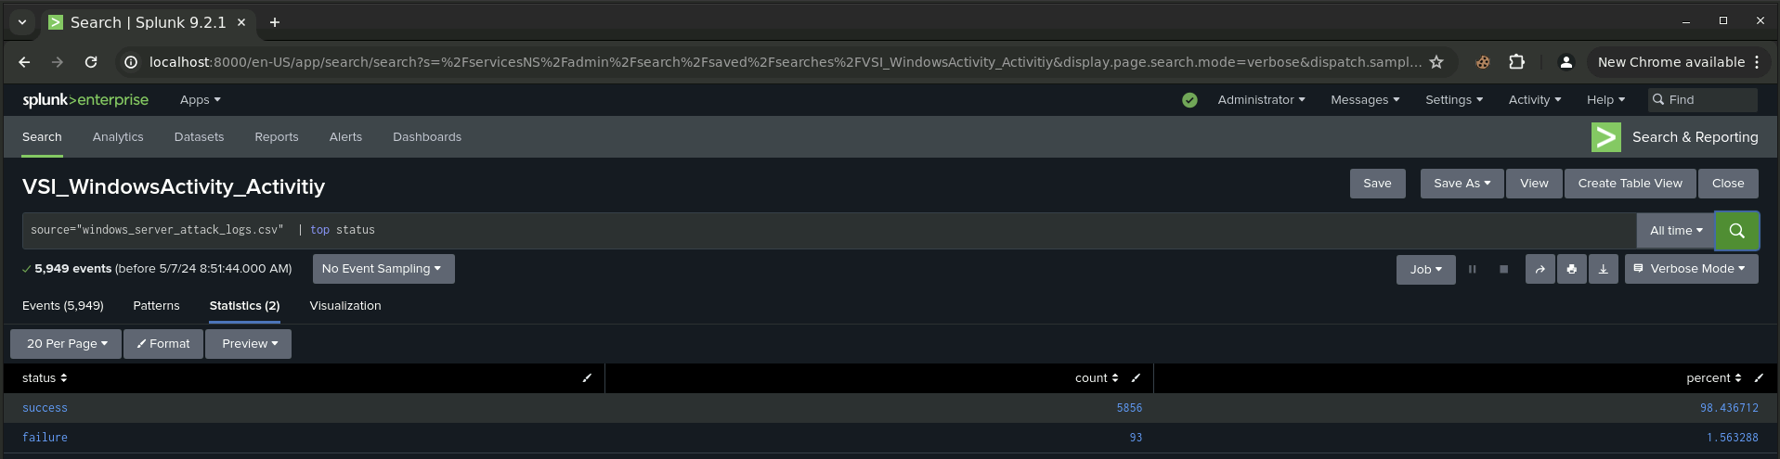
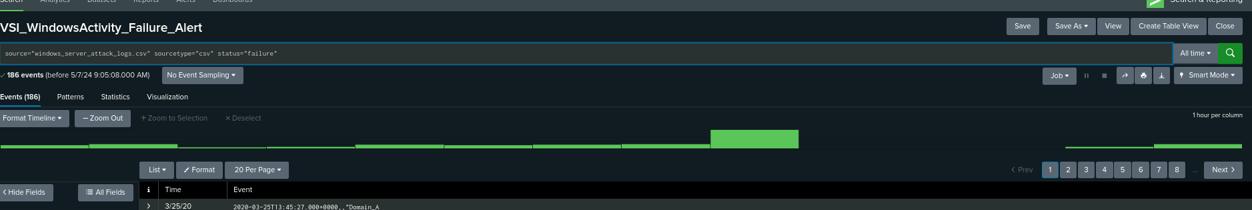
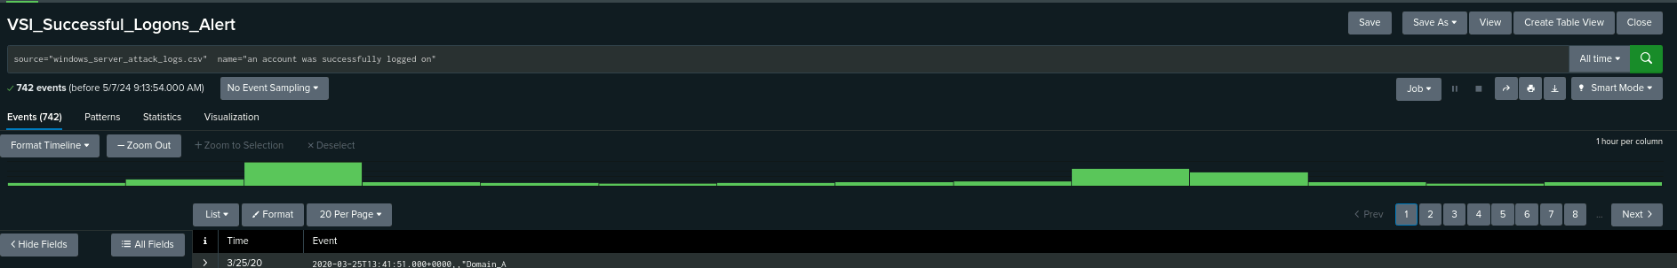
Screenshots of Attack Logs - Windows

Slide 33
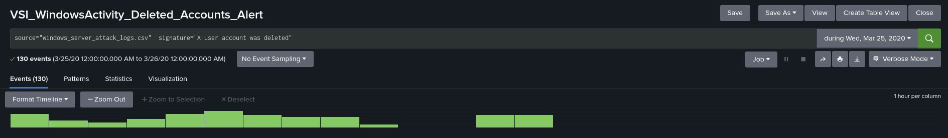

Screenshots of Attack Logs - Windows

Slide 34
Attack Summary—Apache
Comparing the two different logs, there was a drastic increase in POST as well as a significant drop in GET HTTP methods.
Upon investigating the referrer domains in conjunction with the country’s with their respective IP locations in the attack logs, there was a spike in activity from locations outside of the United States.
When comparing the attack logs, we can see an increase in error codes represented by “404” in the HTTP response code.

Slide 35
Attack Summary—Apache
Upon investigating the aftermath of the attack logs, we found that both our alerts for HTTP POST Method and non-US activity would have been triggered.
Our alert threshold for POST Method per hour was 10 and was significantly breached with a total of 1296 events on March 25 2020 at 8PM
Our alert threshold for International activity per hour was 250 and was breached with a total of 937 events on March 25 2020 at 8PM
After collaboration between the team we agreed that the set in place thresholds were still reasonable values

Slide 36
Attack Summary—Apache
After investigating the dashboards, we can extrapolate the following
GET attack on Apache withheld for the duration of 5pm to 7pm on March 25 2020 and peaked at 729 events
POST attack on Apache withheld for the duration of 7pm to 9pm on March 25 2020 and peaked at 1296 events
Looking at the international activity through our cluster map excluding US activity, we can see a significant increase in countries that would not normally be engaging with the server during normal traffic

Slide 37
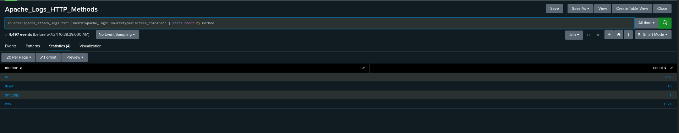
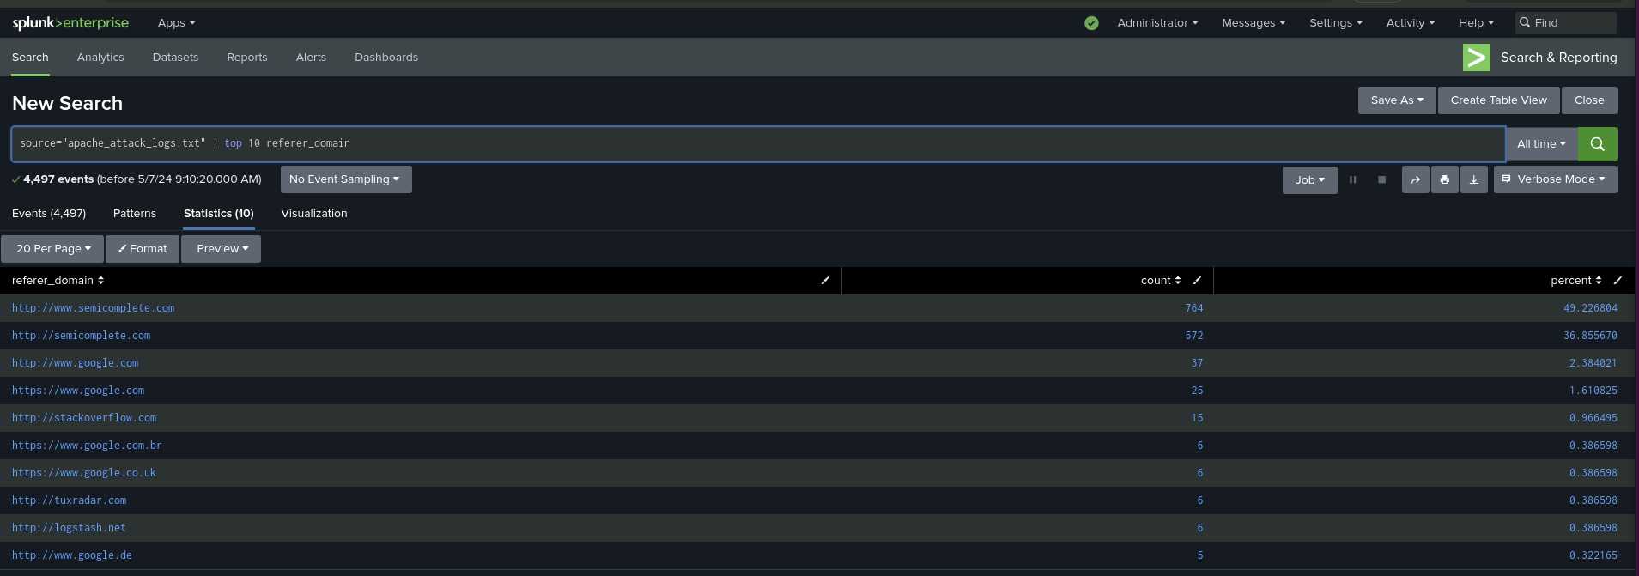
Screenshots of Attack Logs - Apache Reports

Slide 38
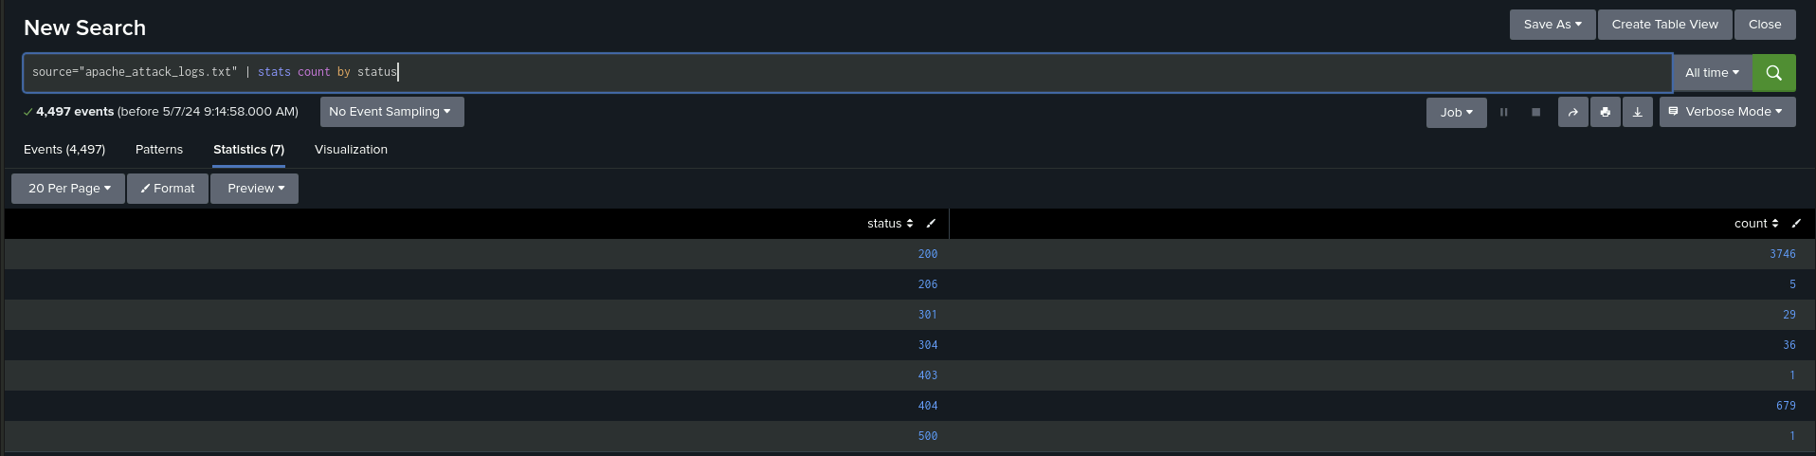
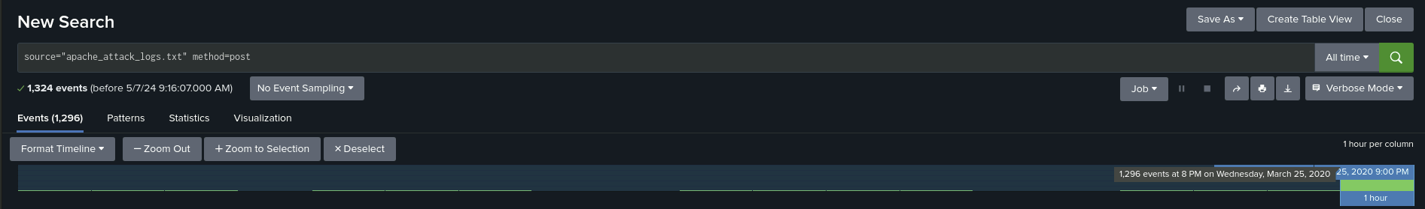
Screenshots of Attack Logs - Apache Alerts

Slide 39
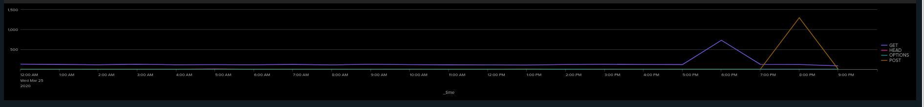
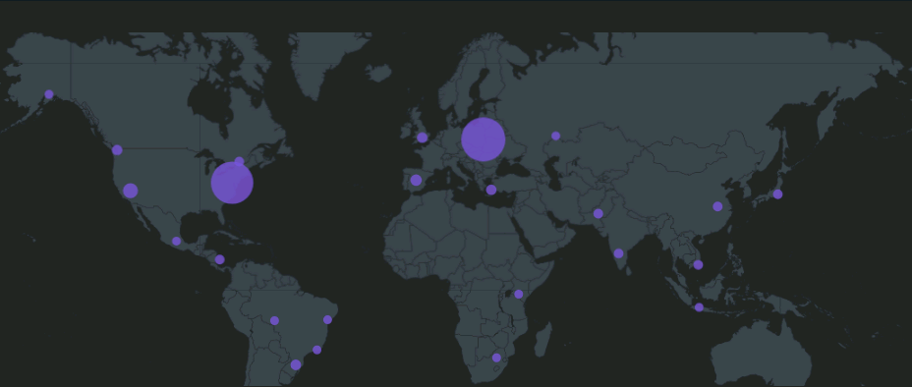
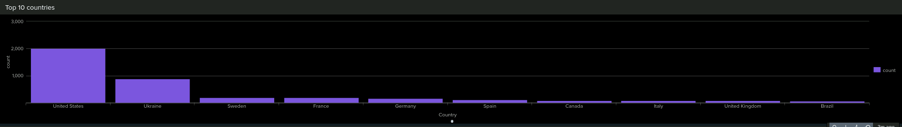
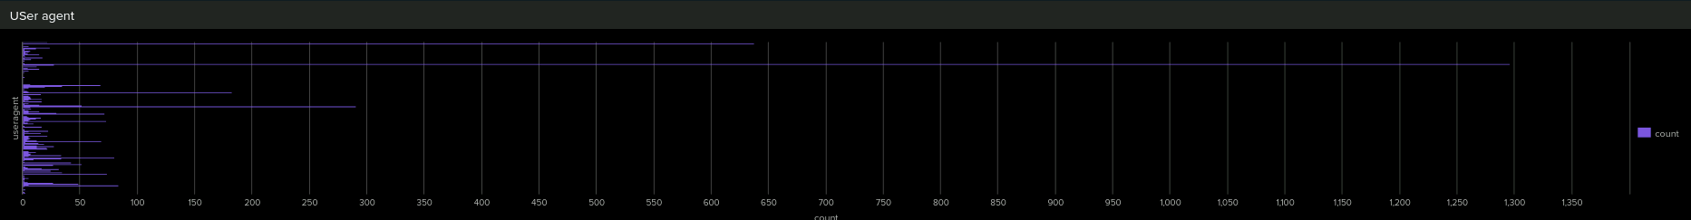
Screenshots of Attack Logs - Apache Dashboard

Slide 40
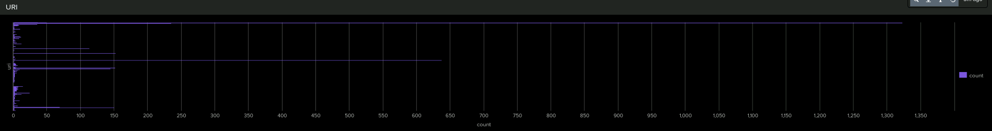
Screenshots of Attack Logs - Apache Dashboard

Slide 41
Summary and Future Mitigations
‹#›

Slide 42
Project 3 Summary
On March 25, there was a significant spike in attacks in resetting a password resulting in activity being performed by foreign individual who otherwise would not have access to the network.
To avoid this in the future we suggest:
Ensuring that all users within the network have up to date training and have been educated in a strong password policy
Multi-factor authorisation against brute force attacks
Lock out certain users after a certain amount of attempts.

